Slide 1
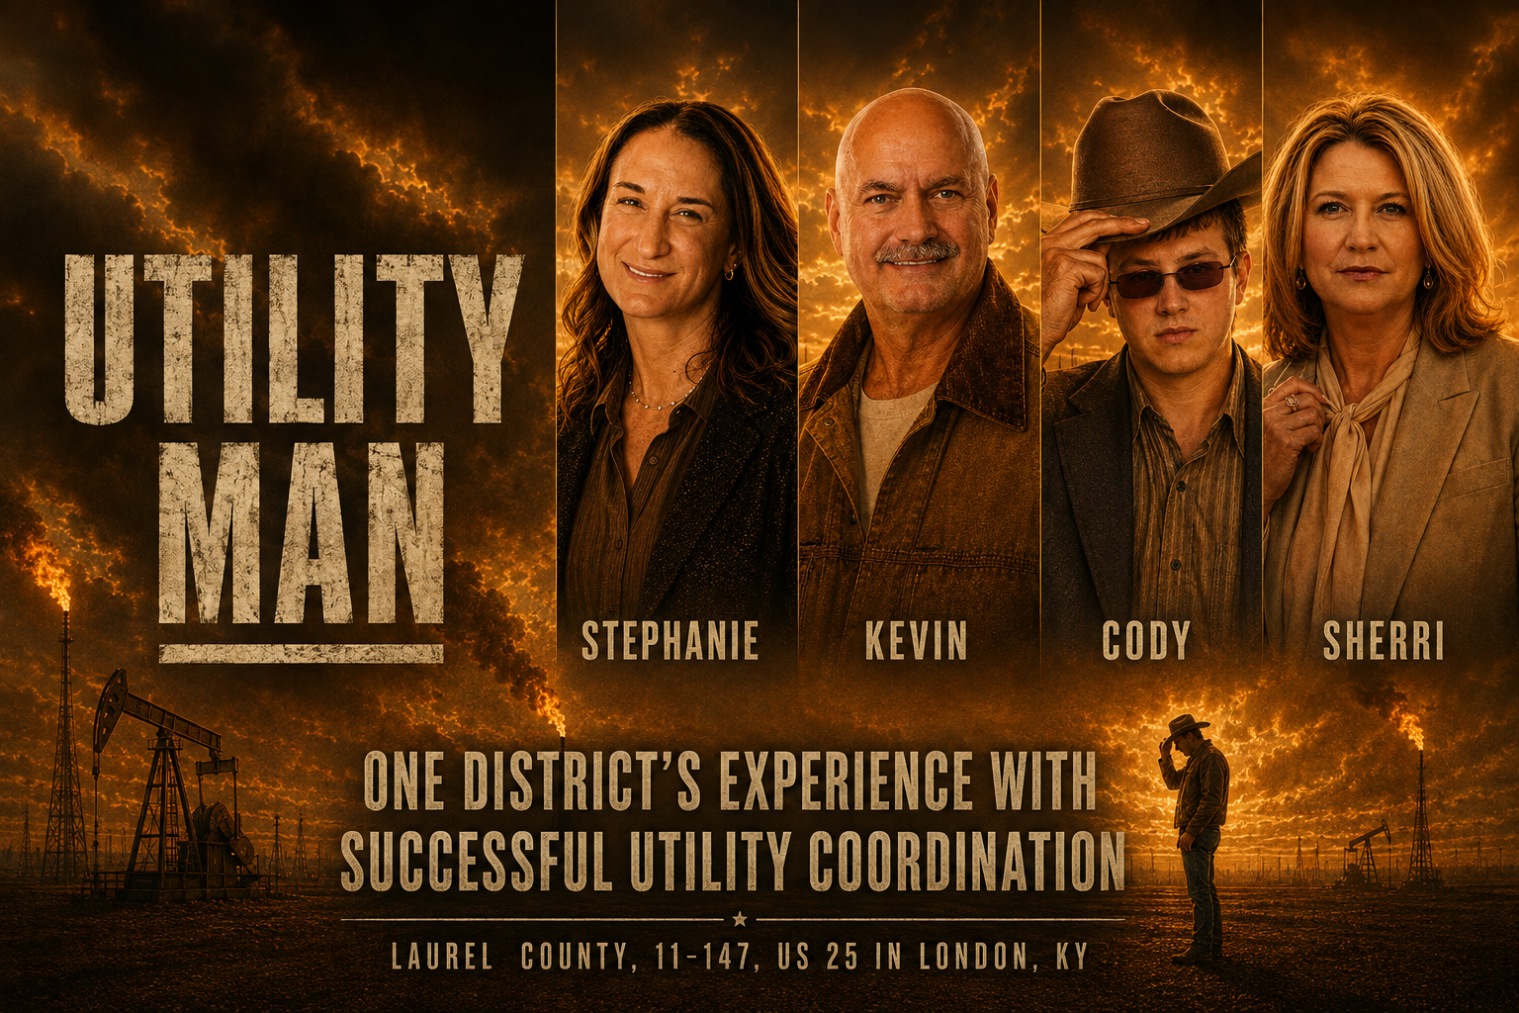

Slide 2


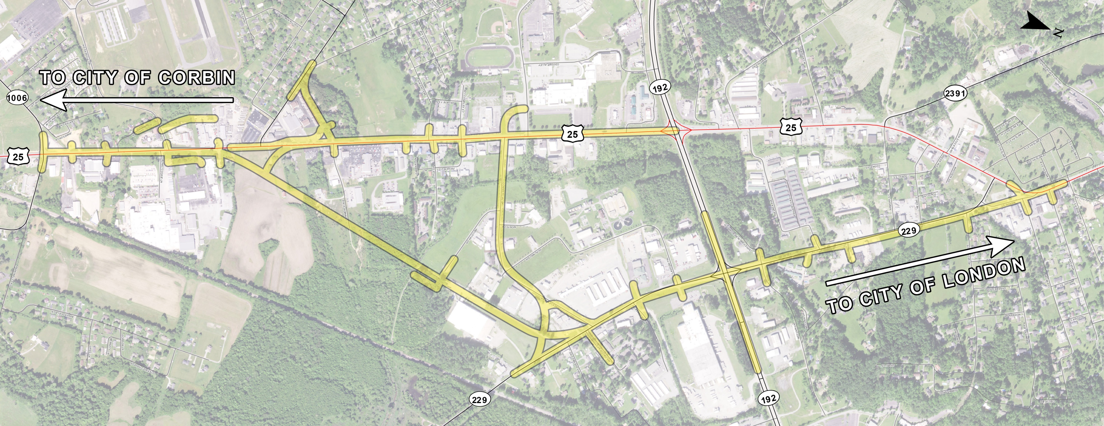
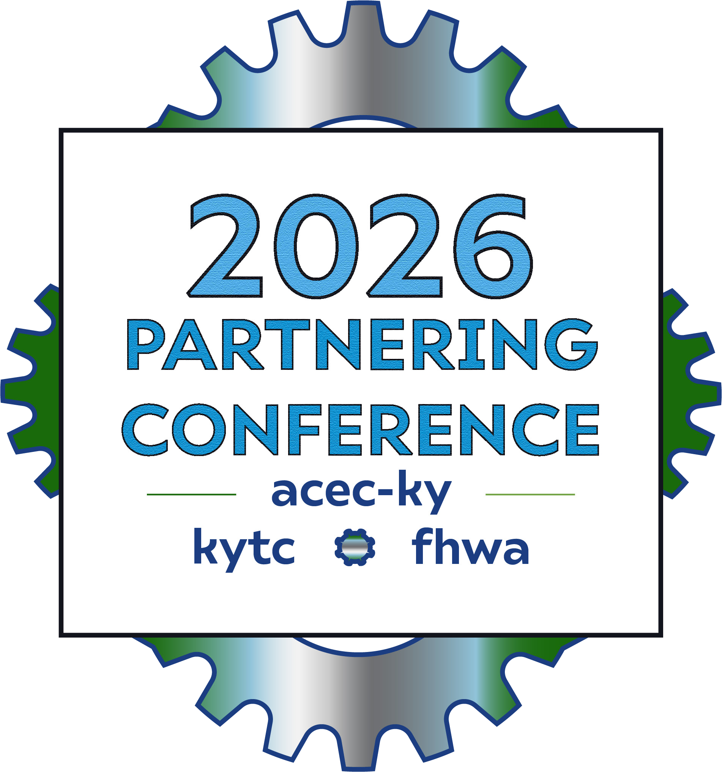
11-147Reduce congestion and improve access on US 25 and KY 229
August Letting $68.4M
3.7 miles 5 lane template
129 Parcels (101 Appraisals)
10 Utility Companies
Notes:
Sherri

Slide 3

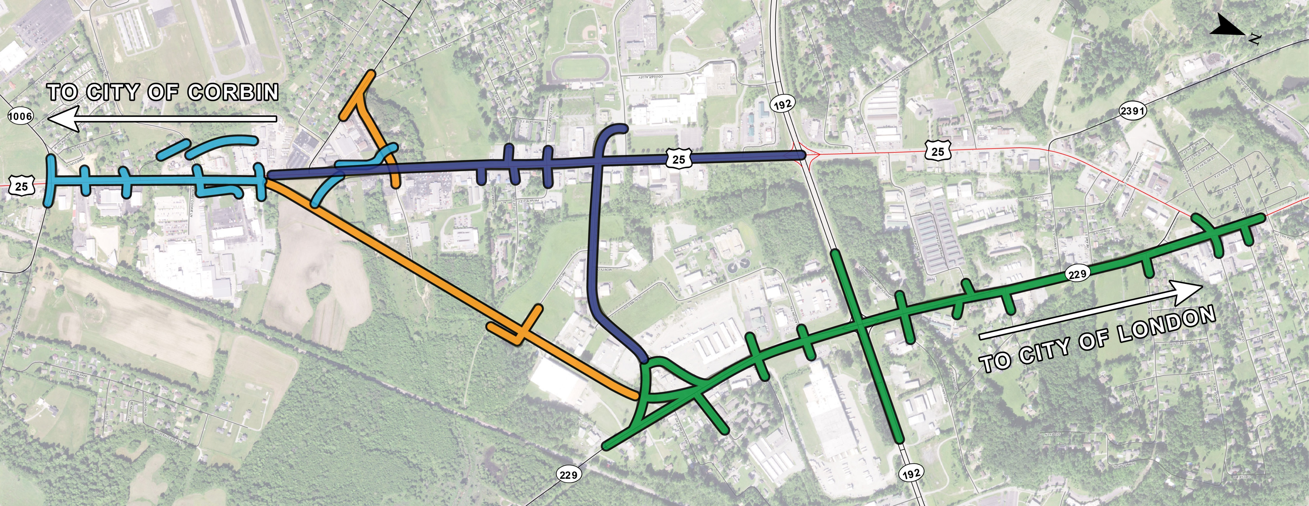
Project Schedule
Original Anticipated Letting Sept 2025
Actual letting August 2026
Let 8/20 Awarded 8/21
Precon Meeting 9/2
Contractor Utility Coordination Meeting 9/8
Maintenance of Traffic Schedule
Milestone 1 completion date May 1, 2027
Milestone 2 completion date November 30, 2027
Milestone 3 completion date July 1, 2028
Milestone 4 completion date June 30, 2029
Notes:
Sherri

Slide 4
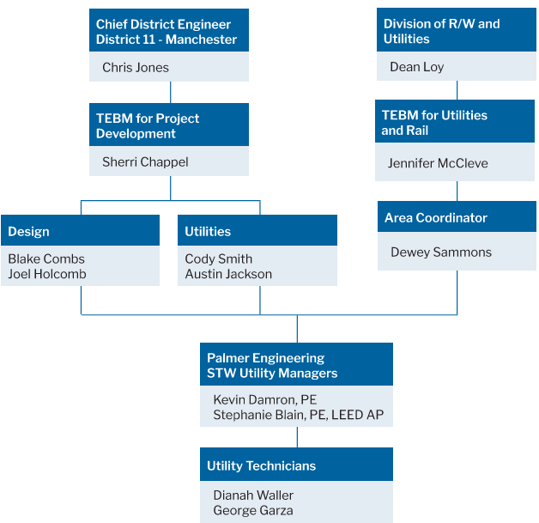












Notes:
Sherri Slide
Recognize the D11 Core Team Members (Blake, Joel, Austin, Cody) (David Fields)
Introduce why KYTC turned to the STW Utility Management contract.
Reflect on your experience and why you recommended this project for the presentation.
The theme is “creating opportunities from challenges”
This project gave us a good opportunity to build relationships with our utility partners that we work with on many of our projects.
Kevin Damron

Slide 5
Landman Project Management Lessons
Bridge the Gap Between Stakeholders
The Lesson: A landman acts as the ultimate middleman, translating the demands of executives down to the roughnecks working in the dirt.
PM Application: Protect your team from unrealistic demands while keeping leadership informed with honest, jargon-free progress updates. Your job is to make both sides understand each other's constraints.
Notes:
Kevin Damron
In the series Landman, Billy Bob Thornton plays Tommy Norris, who is a landman for an oil company in Texas.
This is one my favorite shows because it follows the chaotic life of a Project Manager with lots of drama, explosions, and personalities.
I think it is easy to draw a connection between what Tommy does and what we do with the Kentucky Transportation Cabinet to manage our projects.
We are the middlemen and women between Kentucky Leadership (KYTC, Governor, General Assembly, County Judges, etc.) and the general public, property owners and utility companies.
Our job is to help all parties by working through the project challenges to get the project constructed.

Slide 6
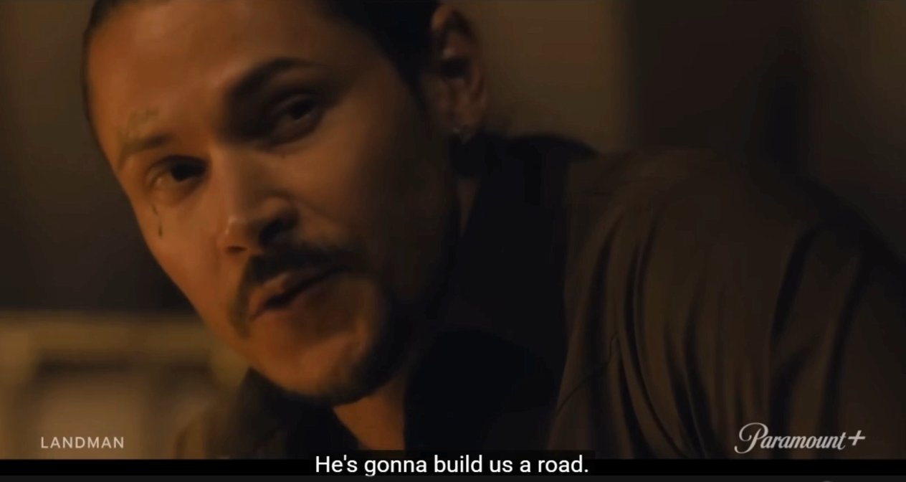
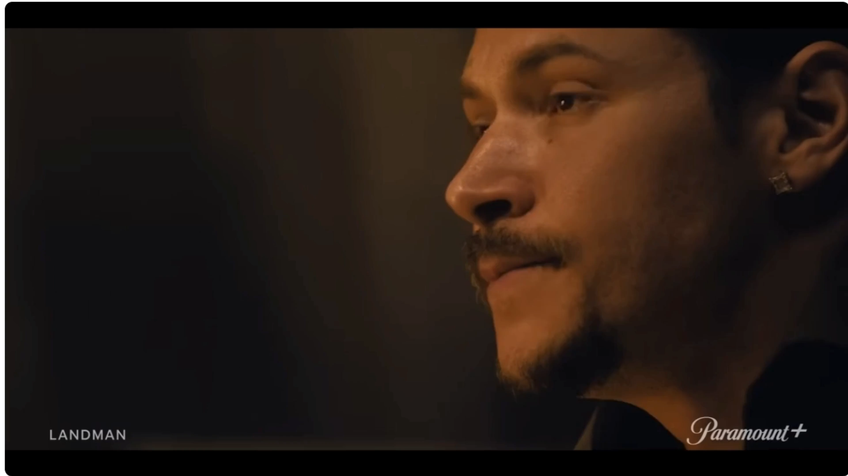
Notes:
Kevin Damron
I recently participated in a meeting with Dean Loy, Director of Right of Way and Utilities, on our project.
I just so happened to have secretly filmed Dean and this very intense conversation with the impacted owner.
Play Video

Slide 7


Palmer Engineering Statewide Utility Management Assignment
March 6, 2023 Project Assignment
September 1, 2024 Earliest Anticipated Letting Date
Initial Steps
  Reviewed all available material
  Developed Utility Conflict Matrix
  Met with District Team
  Reached out to all utility companies / provided current plans
  Established Communication with monthly meetings
  Held Utility Coordination Meeting
  Discussed project schedule and goals with the companies
Notes:
Kevin Damron
Palmer Engineering STW Utility Management Assignment (Kevin)
Recognize the Palmer Core Team Members (Steph, Dianah, and George)
Review all of the available material, including past utility coordination records to familiarize yourself with the project.
Met with District 11 Project Team Members to clarify assignment
Reached out to all of the companies and provided updated plans and KMZ file.
Created DGN to identify all the potential utility conflicts
Developed Conflict Matrix in summer of 2023
Provided DGN and Conflict Matrix to Utility Companies to facilitate review of impacts
Held Utility Coordination Meeting, discussed project schedule and goals.
Note: The utility companies have been receptive to our monthly meetings. Positive outcome of COVID and Virtual Meetings

Slide 8
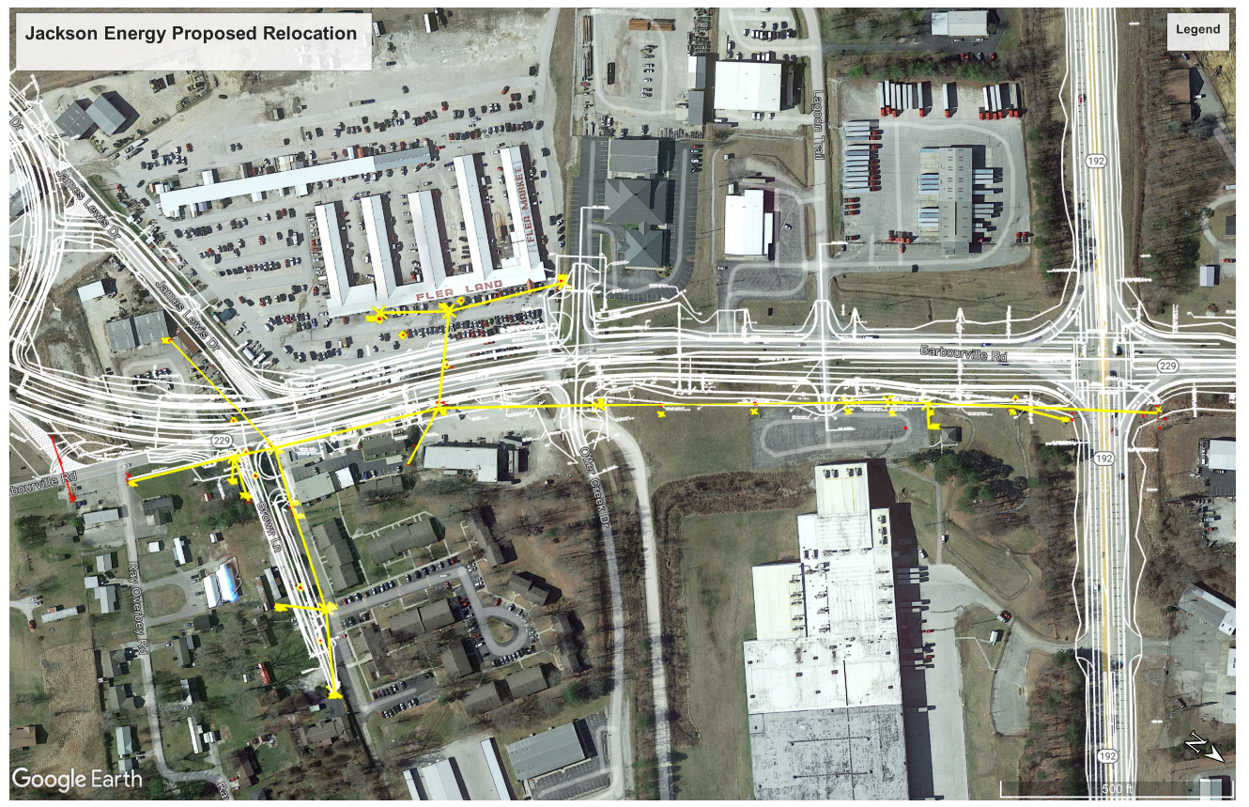
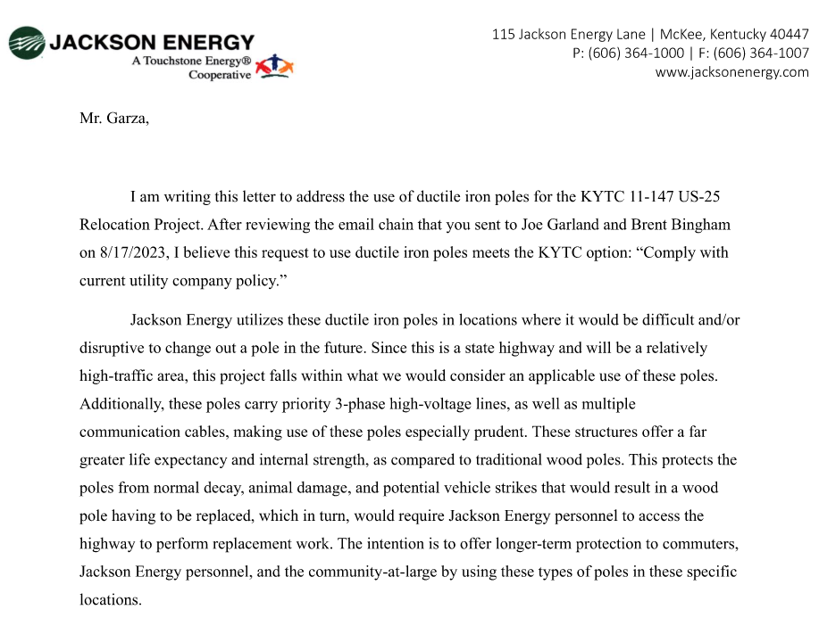
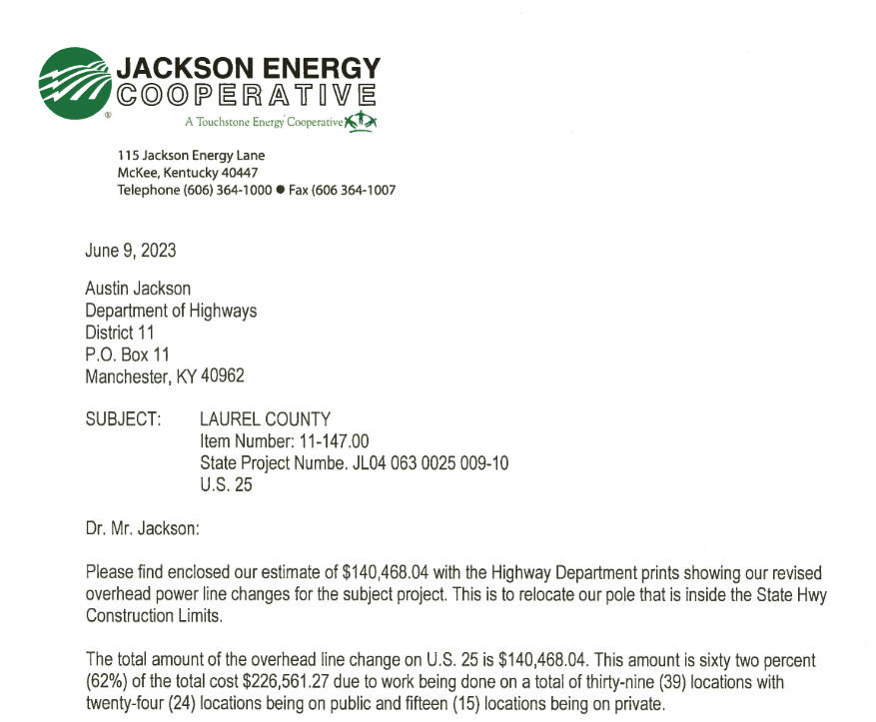
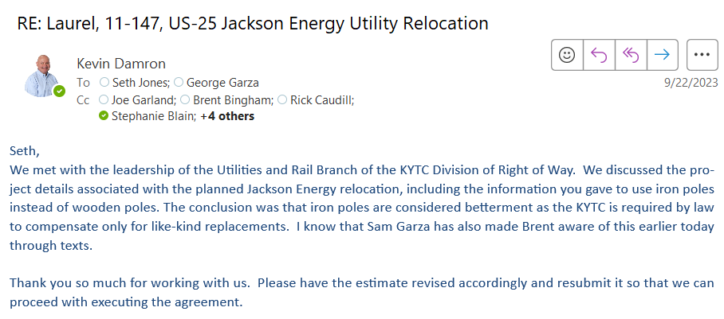
Jackson Energy
Betterment
August 2024 Executed Agreement | October 2025 NTP
Notes:
Kevin Damron
August/September 2023
Jackson Energy – Plans Ready to Execute Agreement
Question of Betterment with the proposed steel poles.
Coordination meetings with CO Utilities to work this out.
Executed Agreement; NTP put on hold due to ROW clearance

Slide 9
Landman Project Management Lessons
Understand the Ground-Level Work
The Lesson: A good landman understands the physical and technical realities of what it takes to plan and execute the project goal.
PM Application: You do not need to be an expert in every technical task, but you must understand your team's day-to-day workflow. Knowing how the work actually gets done helps you spot bottlenecks and set realistic deadlines.
Notes:
Kevin Damron
As project managers, it is our job to understand what it takes to deliver our projects.
We don’t have to be the expert. But we need to keep the project flowing and to involve the needed experts.

Slide 10
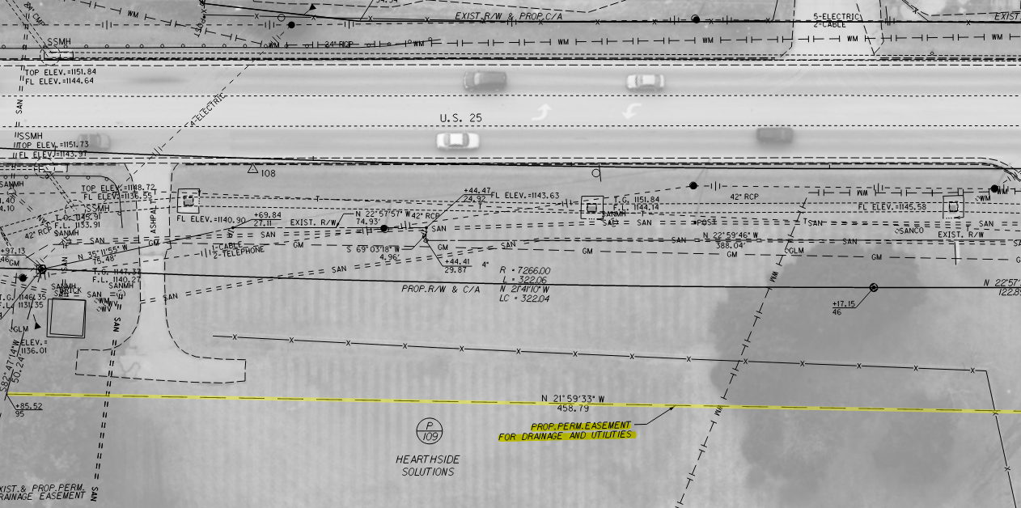

Changed Plans to have Utility Easements
Notes:
Cody Smith
The project had been originally designed with no utility easements. After meeting with the utility companies, District 11 decided to change all of the permanent drainage easements that had not been acquired to include utilities.
Old plans had permanent drainage easements. Utility companies asked if we could change the easements to include utilities. We did an onsite utility meeting and decided to change the easements to “permanent drainage and utility estimates”.
The only catch was that about 1/4 of the property had been acquired on the south end of the project and these parcels could not be changed.
You’ll see that some of these areas are where we continue to have issues with property owners.

Slide 11

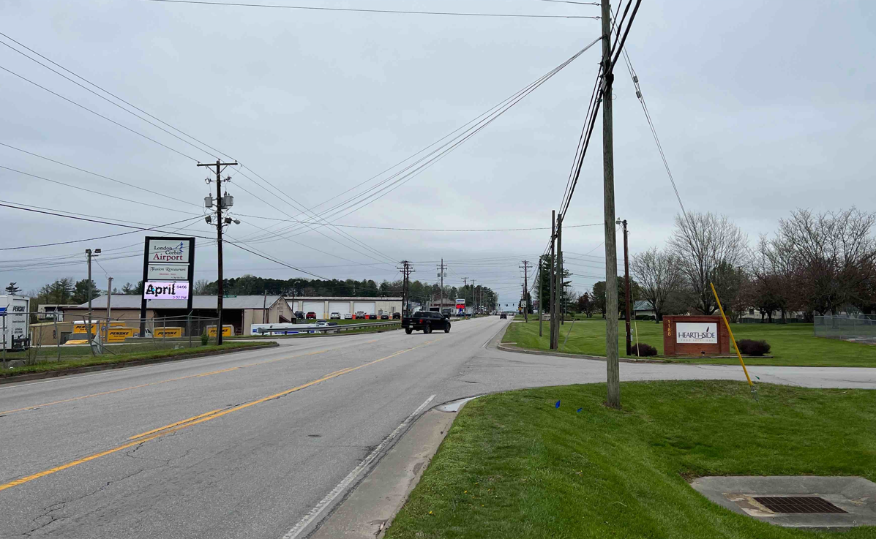
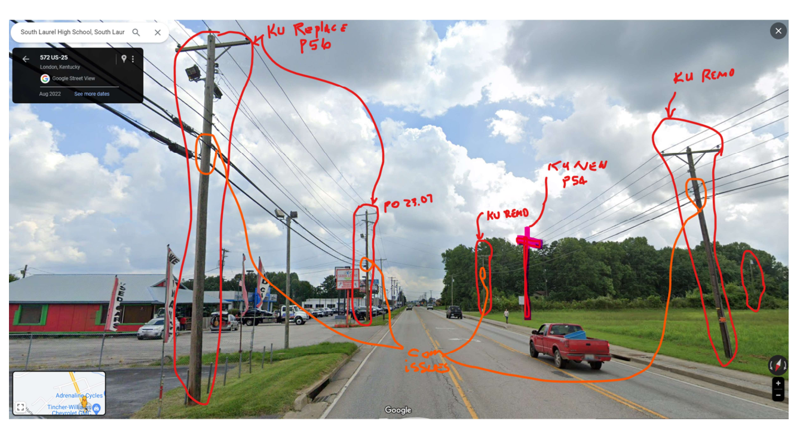
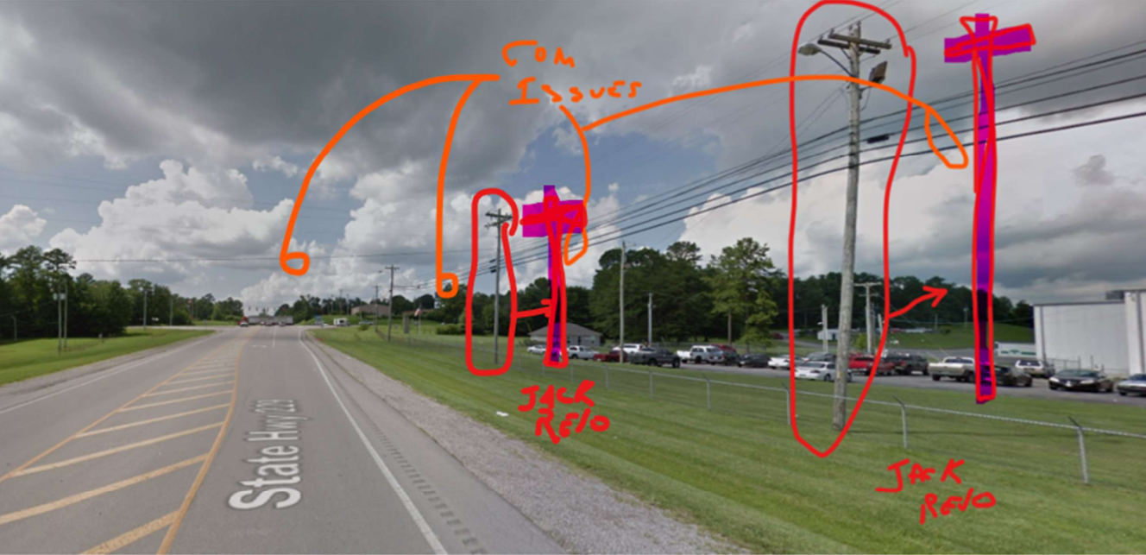
Met Individually with the Utility Companies
Windstream decided to abandon their individual route and to place their facilities on KU and Jackson Energy pole lines.
Notes:
Individual Meeting with Windstream
George Garza met with Tommy Lewis Onsite
Individual Meetings help to establish personal connections.
All parties have a clearer understanding of the project.
Windstream decided to abandoned their individual route and to place their facilities on KU and Jackson Energy pole lines.

Slide 12

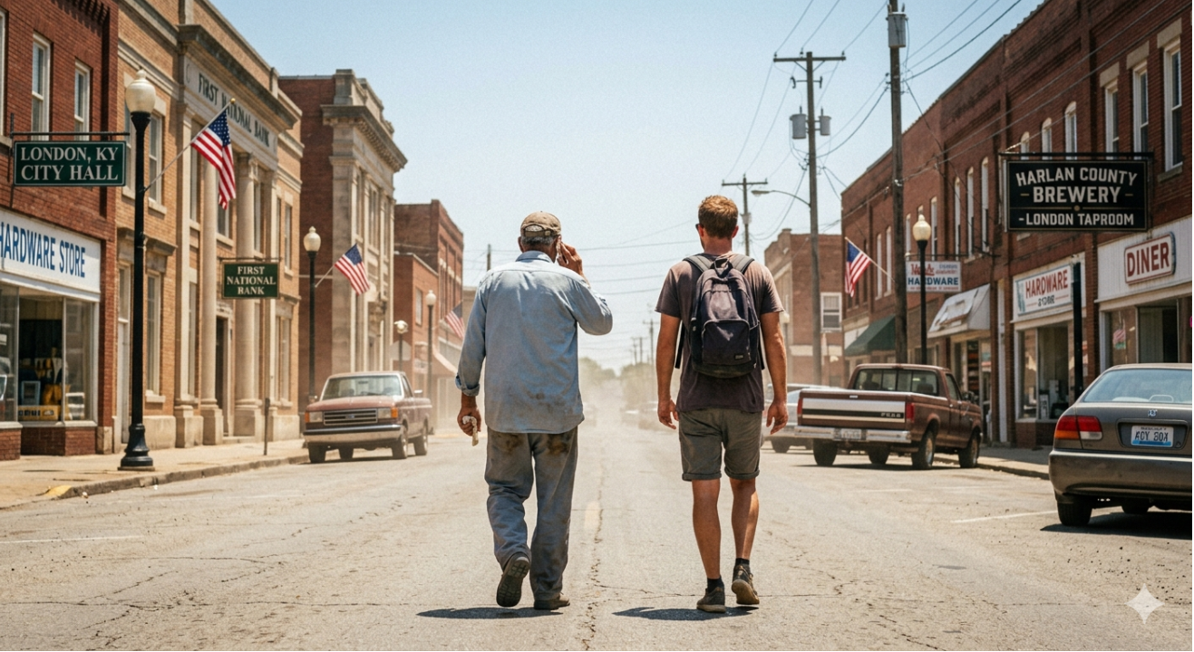
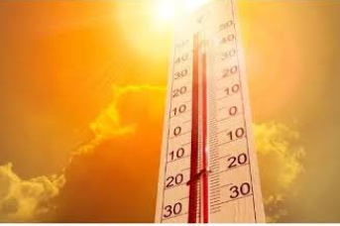

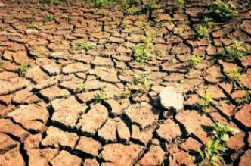

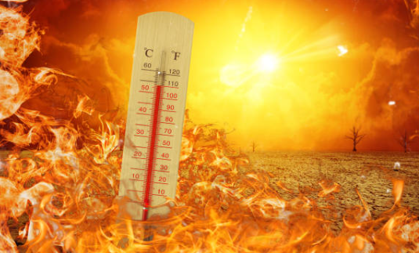
Windstream Onsite Meeting
How hot was it?
Notes:
Kevin
Individual Meeting with Windstream
George Garza met with Tommy Lewis Onsite
Walked the corridors in each direction in 100-degree weather
How hot was it? Did I hear someone ask, “How hot was it?
It was so hot the chickens were laying hard-boiled eggs.
It was so hot, they saw a guy on the street with a sign that said, “Will work for shade.”
It was so hot, they bought a frozen pizza for lunch and let it bake as they walked down the street.
It was so hot they saw the devil in Walmart buying an air conditioner.
It was so hot the artificial flowers were wilting.

Slide 13
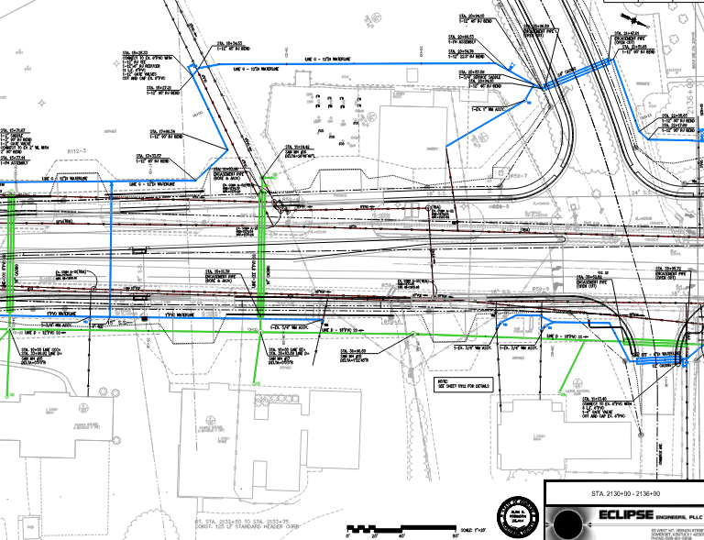
London Utility Commission
Significant water and sewer impacts for London Utility Commission (LUC)
Relocation estimates totaling approximately $14 Million ($2 million betterment)
Plans to be included in the highway contract – work to be done by the highway contractor.
Met with Eclipse Engineering quarterly, then monthly, and now weekly.
Project Included:
  11,419 LF – 12” DI
  4,205 LF – 6” DI
  5,415 LF – 8” PVC
  1,695 LF – 8” PVC
  2,000 LF – 4” PVC Gravity Sewer
  2,000 LF – 6” Gravity Sewer
  $1.2 Million Sanitary Sewer Pump Station
Notes:
LUC - $13 million water, sewer, including a pump station. ($2 million betterment)
Plans to be included in the highway contract – work to be done by the highway contractor.
Met with Eclipse quarterly, then monthly, and then weekly.
Quarterly – Stephanie Blain would lead the review of the preliminary design plans, ask questions, point out opportunities for changes to reduce the relocations.
- Having an experienced engineer who designs water and sewer line relocations was crucial during this stage of the project. Stephanie provided a fresh review of the project that benefited both KYTC and LUC. She would sometimes ask some hard questions, but also offer suggestions on how to design the relocation differently.
Said work is to be completed with 90.0726214% of the costs to be borne by the Cabinet and 9.92737857% of the costs to be borne by the Utility Owner

Slide 14
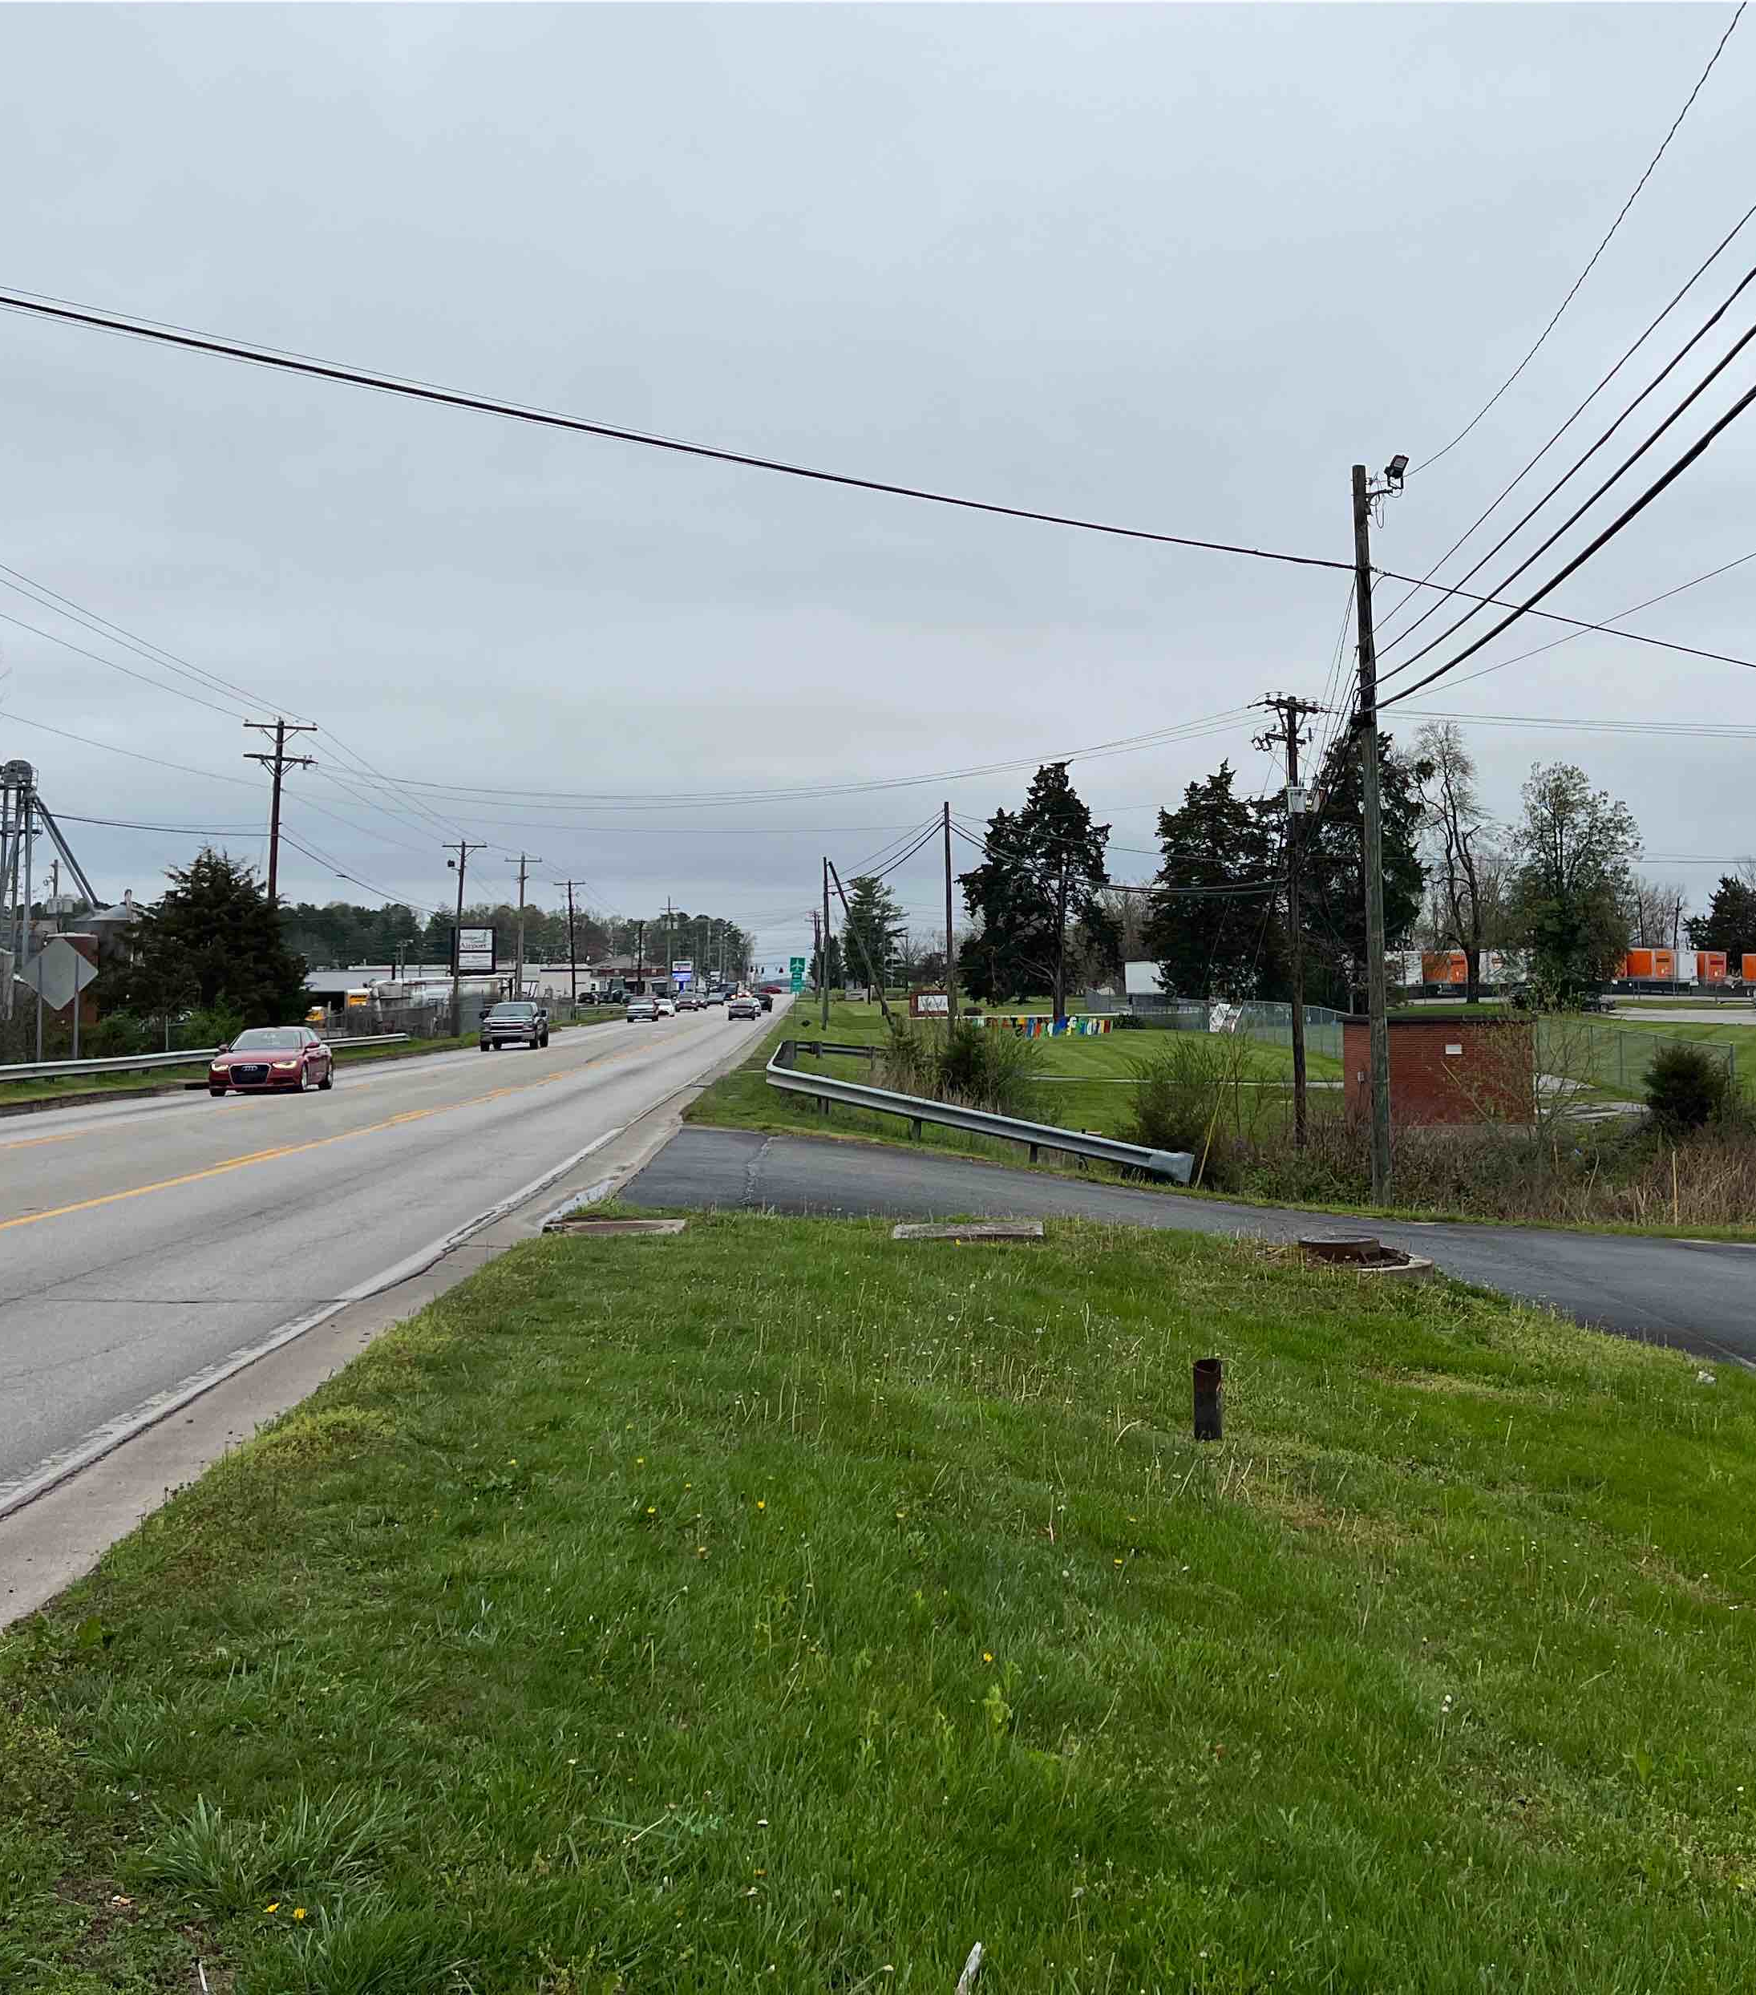
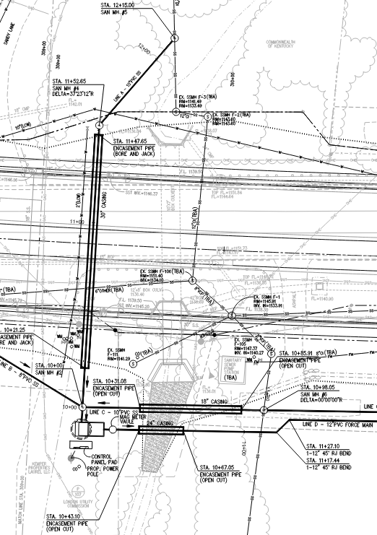
London Utility Commission - $2 Million Betterment
$2 million Betterments – this took a village to work out.
Engineering agreement.
Involved CO Utilities
Is the Pump Station a betterment?
Notes:
Transition to Cody
$2 million Betterments – this took a village to work out.
- First with the engineering agreement. We had to work through the preliminary plans, estimate, and work through all of the details.Involved CO Utilities (Jennifer, Dewey, Justin Reichenbach, and Sean Johnson)
o The pump station – We had to determine if this was a betterment or not. We eventually concluded that the existing pump station could not be avoided. Expand on this… Partial Betterment.
o Expand on the betterment discussion. (decimals…..)
We also had the luxury having a another experience engineer (Mike Flynn) with availability to review the final plans during the last few months of the plan development. Mike got into the weeds of quantities, particular fittings, and helped to fine-tune the final relocation plan set.
Also – What do you do with the original engineering agreement?

Slide 15
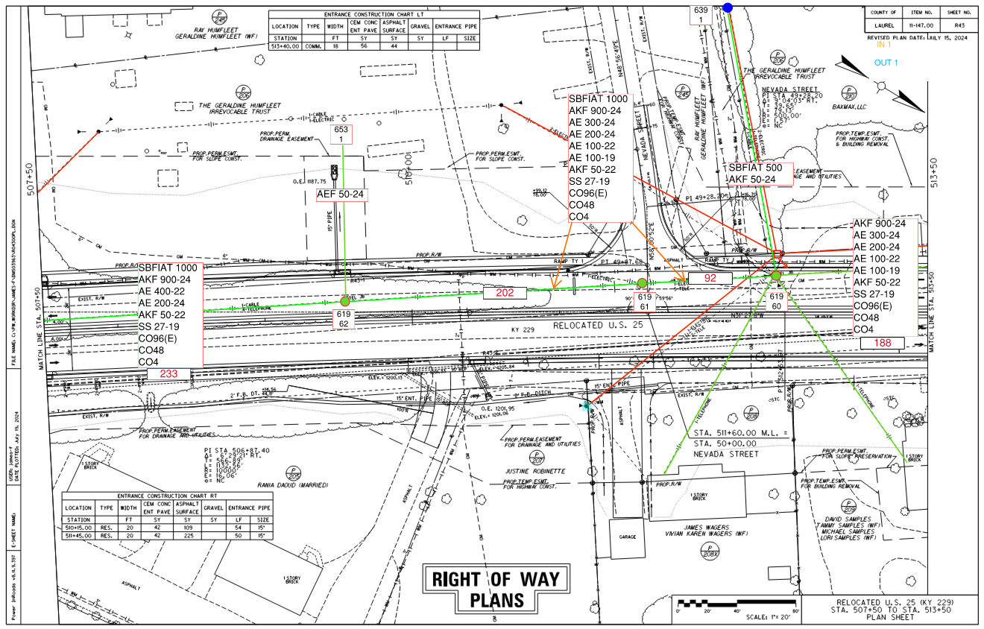
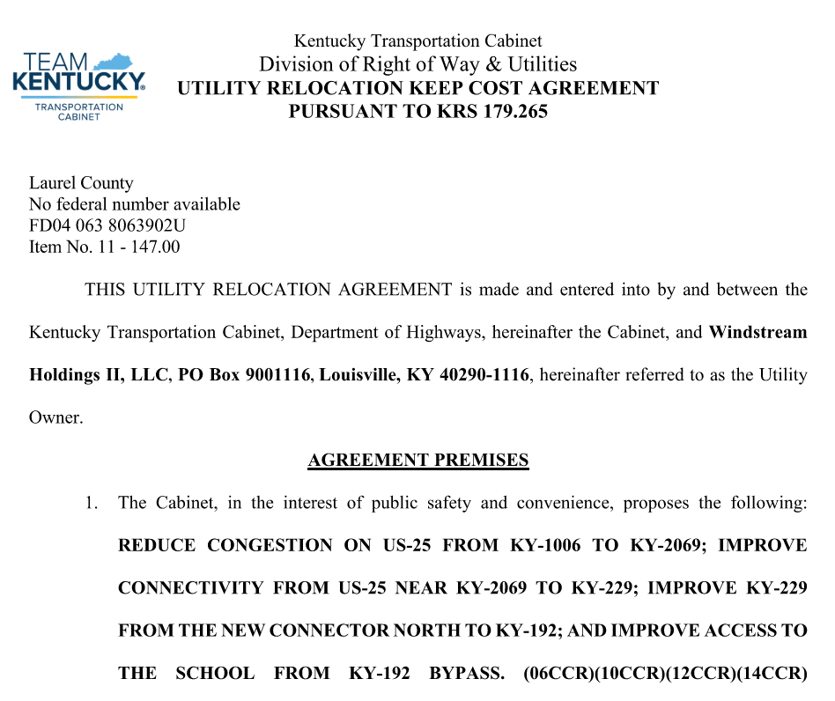
Windstream Agreement
Notes:
Cody
Talk about how you worked with Tommy to finalize his plans and estimate for the utility agreement.

Slide 16
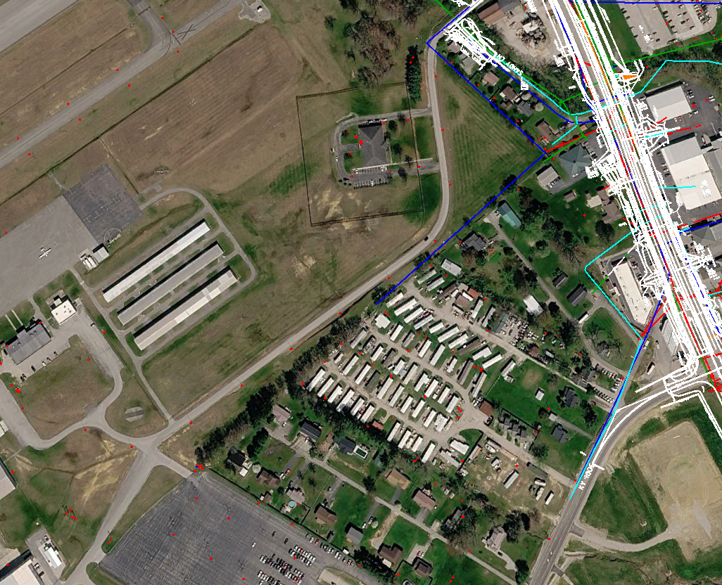
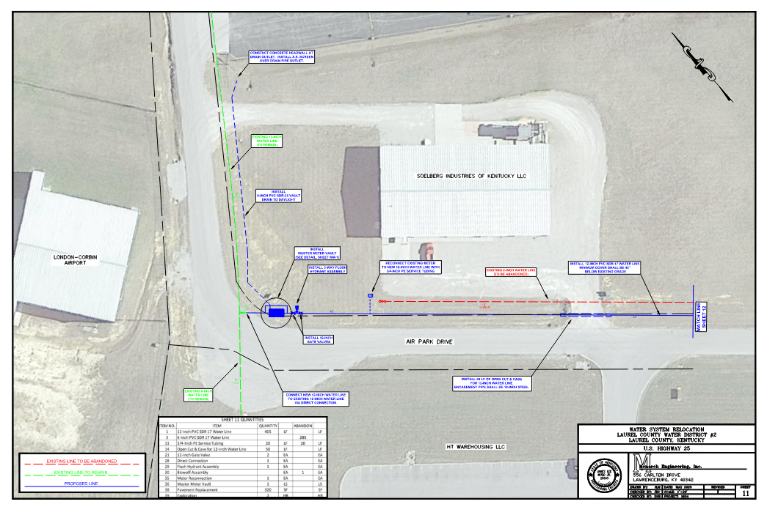
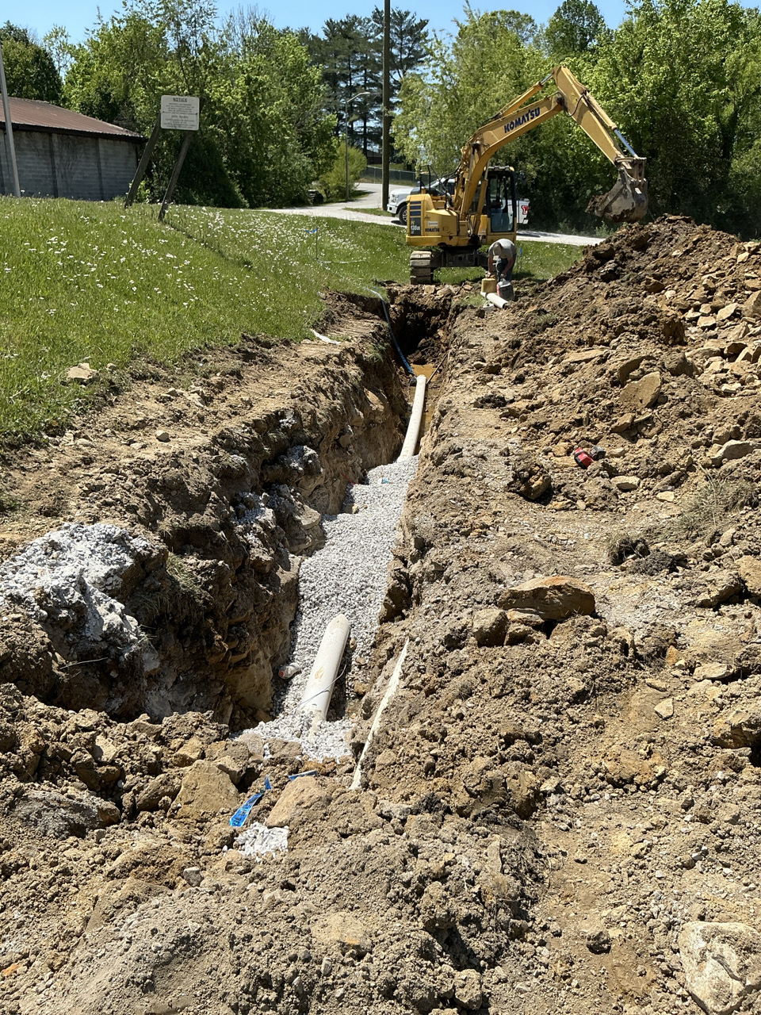
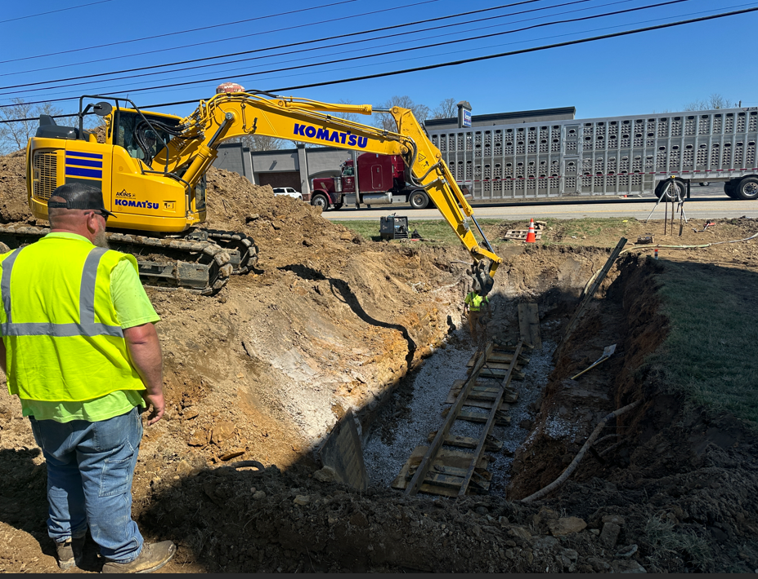
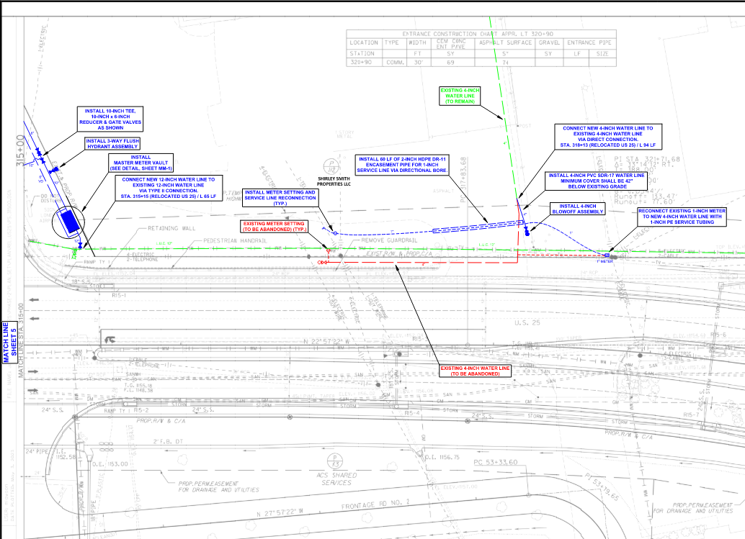
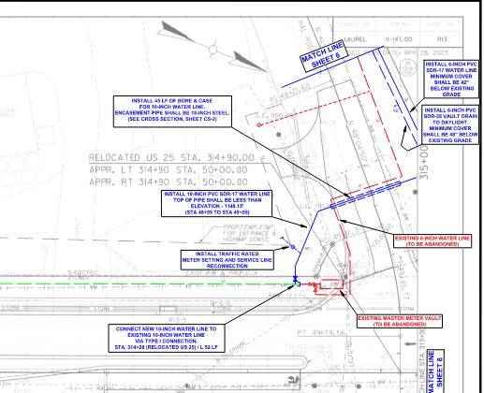
Laurel County Water District #2 (LCWD#2)
Notes:
Cody
we engineering agreement was already in place when we started. The engineering firm was working in their relocation plans.
When we received their plans Cody started questioning some of the proposed relocations as potential betterments. Need to expand on this…. Local knowledge is always valuable. He knew the area and questioned some of the reasoning behind what they were doing.
Required coordination meetings with CO Utilities, including Jennifer, to work this out. The plans had been developed and presented earlier but no one had questioned the betterments. We developed a more practical solution, which would cost less, but also required the engineering firm to have to updater their design. Since all parties had some stake in this, KYTC agreed to pay for the engineering fees of the redesign.
Once the plans were approved, the agreement was executed for the company to complete the relocation. Once again, we didn’t give NTP because ROW wasn’t cleared.

Slide 17
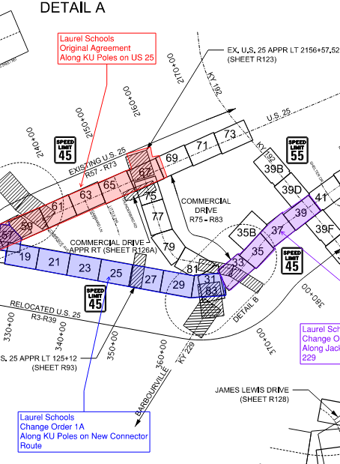
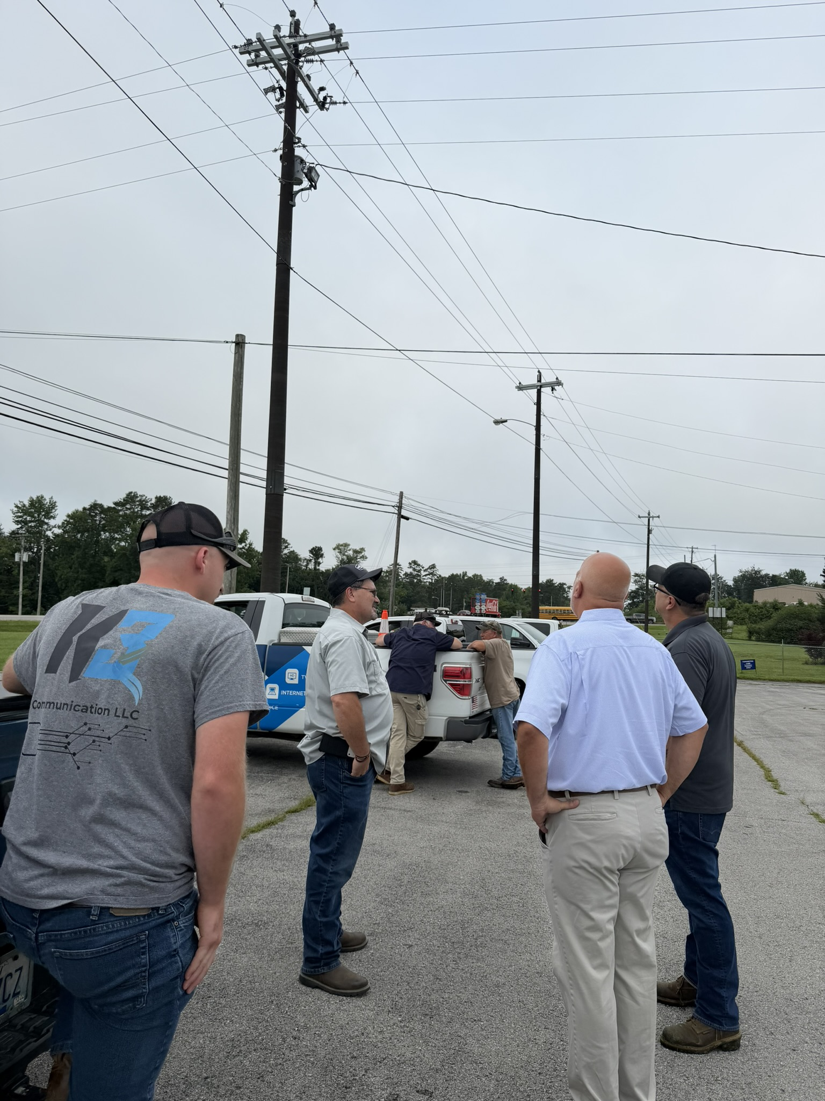
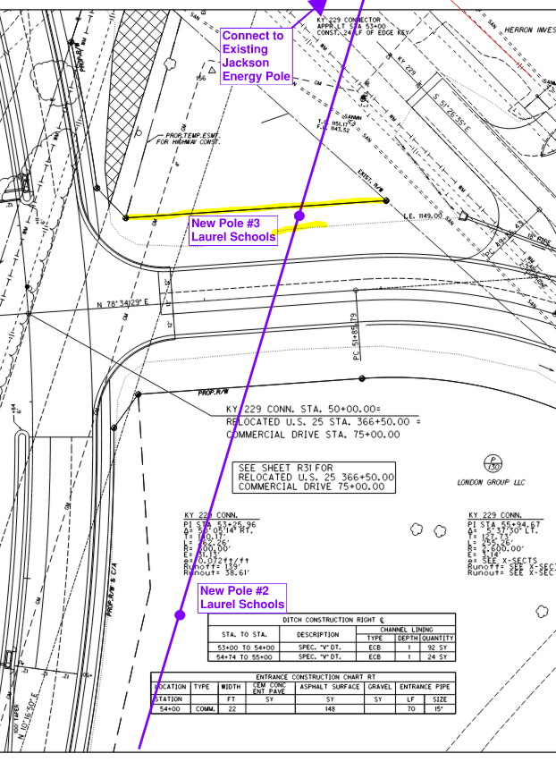
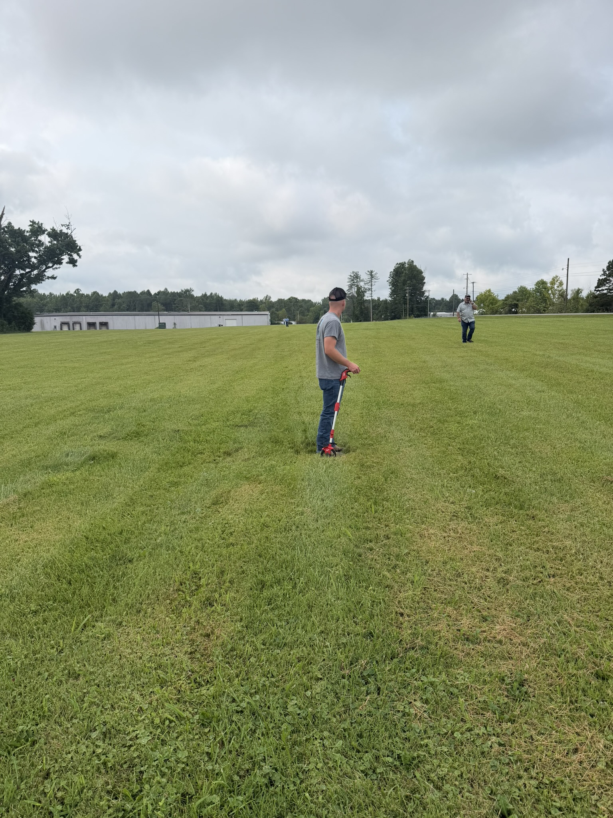

Laurel County Schools – No Experience with KYTC Process
September 2025 – Executed Agreement
For Only Along US 25 (red)
August 2026 - CO#1 (purple)
Required August Onsite Meeting
Establish Line Order on Poles along KY 229
Establish Locations for 4 New Poles
Notes:
Cody
Not familiar with the KYTC process or plans. Great guys and easy to work with.
We had to guide them through the process by taking their relocation concepts and showing the pole line on the plans sheets. We met with them in the field to assist with the pole locations.
Initially, Laurel Schools thought their only impacts were along US-25. We asked them to review other sections of the project multiple times.
We eventually determined that they were the first line down under on the new KU section and the Jackson Energy poles.
We also had to work with Laurel Schools to set 3-4 new poles to make it work.
got their plans, estimate and agreement executed early, but had to hold the NTP because of ROW clearance.

Slide 18
Landman Project Management Lessons
Managing Chaos
The Lesson: Billy Bob Thornton’s character, Tommy, lives in a constant state of pressure. Every episode is layered with overlapping crises: financial risk, workplace conflict, family strain, ethical dilemmas, and sheer exhaustion. There is rarely a clean resolution before the next problem arrives.
PM Application: What resonates is not that he handles everything perfectly. He does not. Physically, emotionally, and relationally, the toll is visible. But the show captures a reality many professionals recognize: leadership is often less about balance and more about navigation.
Notes:
Kevin

Slide 19
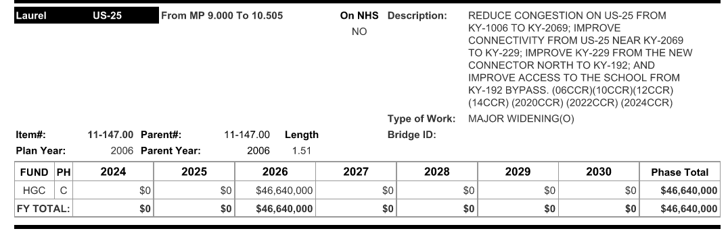
HGC Funding = High Priority Project
September/October 2025 “Firm” Letting Date Set
ROW and Utility Coordination Activities Ramped Up
KY 192 Pavement Rehab was added to the project letting
Goal: All Agreements Executed by August 2025
Notes:
Kevin
Another twist with the project occurred with the 2024 Highway Plan -- HGC Funding
Communicated the Fall 2025 Letting Date to all utility companies in December 2024. Requested plans and estimates asap, but no later than June 2025. Set goal to have all agreements executed by August 2025. We were already meeting monthly with the companies and made this goal a clear milestone for everyone to meet.
Developed the phasing plan for utility relocations to match the construction phasing plan.
Added KY 192 to the Project – which added 12 months to our schedule, until it was removed in the 2026 Highway Plan.
We continued meeting monthly with the overhead companies and weekly with LUC.
The KY 192 pavement rehab had been incorporated into the project. This gave the highway contractor a lot of work to do in the first construction season. The new highway plan did not provide funding for this and the work was taken out of the project.

Slide 20
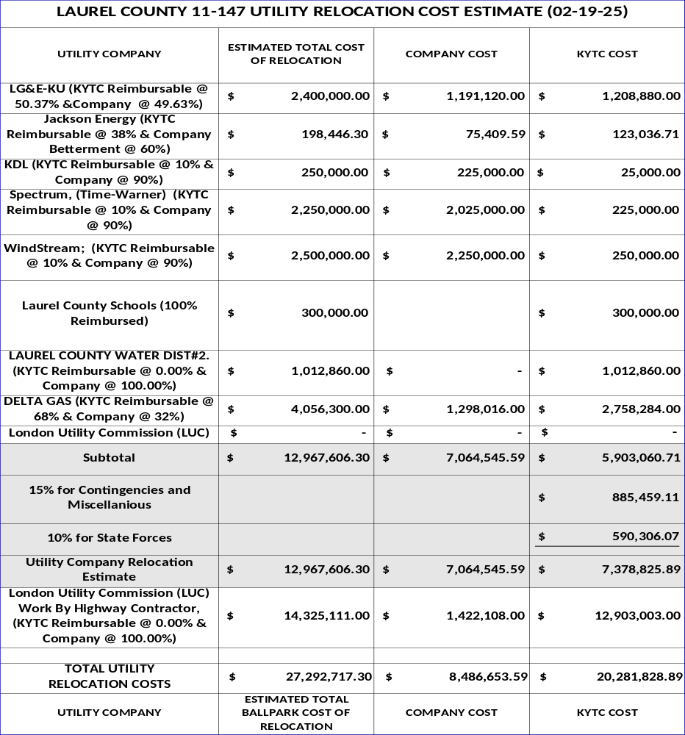
Prepared Updated Utility Cost Estimate
Notes:
Kevin

Slide 21
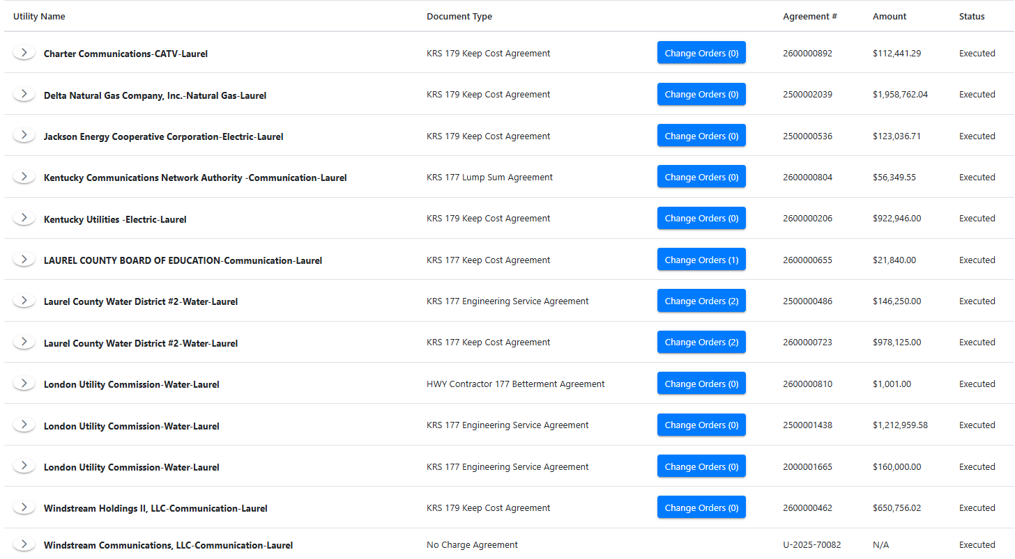
Utility Coordination on Fire!
  December 2025
  June 2025
  February 2024
  November 2025
  July 2025
  September 2025
  March 2024
  October 2025
  November 2025
  April 2025
  May 2020
  August 2025
  October 2025
Notes:
Kevin

Slide 22
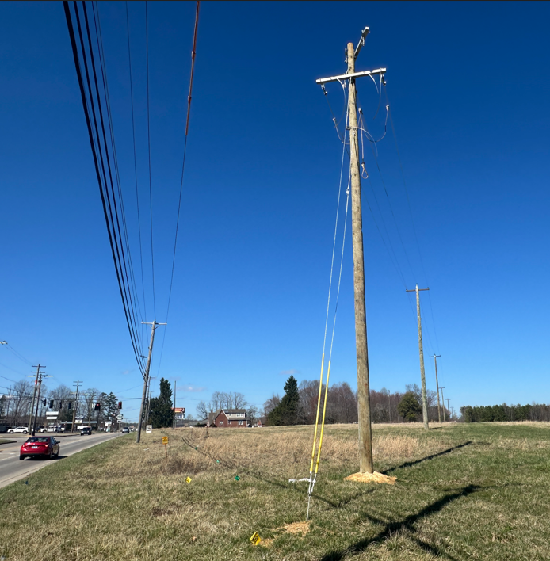
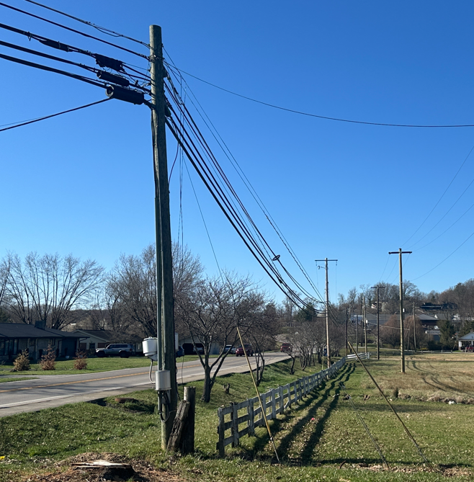
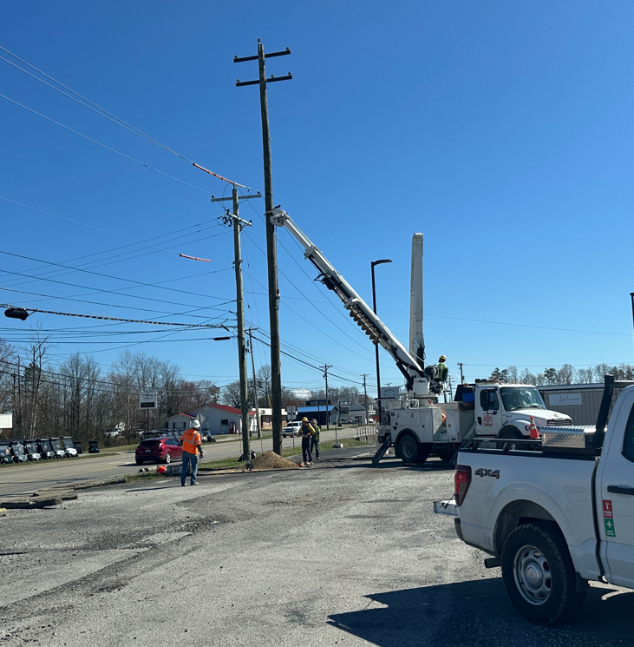
New Connector Route
US 25
KY 229
KY 229
Kentucky Utilities
March 2025 – Received Preliminary Plans
June 2025 – Received Final Plans and Estimate
July 2025 – Executed Agreement
September 2025 – KU began setting poles
February 2025 – Moved to KY 229 Section
May 2025 – Moved to US 25
August 2025 – Had to stop due to ROW
Notes:
Kevin
Plans were first promised by the end of 2024. AT KU’s request, District 11 cleared the trees along the new connector route in November 2024 for KU to get started early in 2025.
Received plans from KU in the spring of 2025. We reviewed their plans and discovered several potential conflicts. We met with them to resolve the conflicts. We were able to shift some of the poles and made minor plan changes to eliminate the conflicts. We also had a few situations where we agreed to live with the tight conditions.
Received final plans in June 2025 and had the agreement executed in July 2025.
KU started setting poles along the new connector in September 2025. Completed this work by the end of the year and moved on to KY 229 in Spring of 2026.

Slide 23
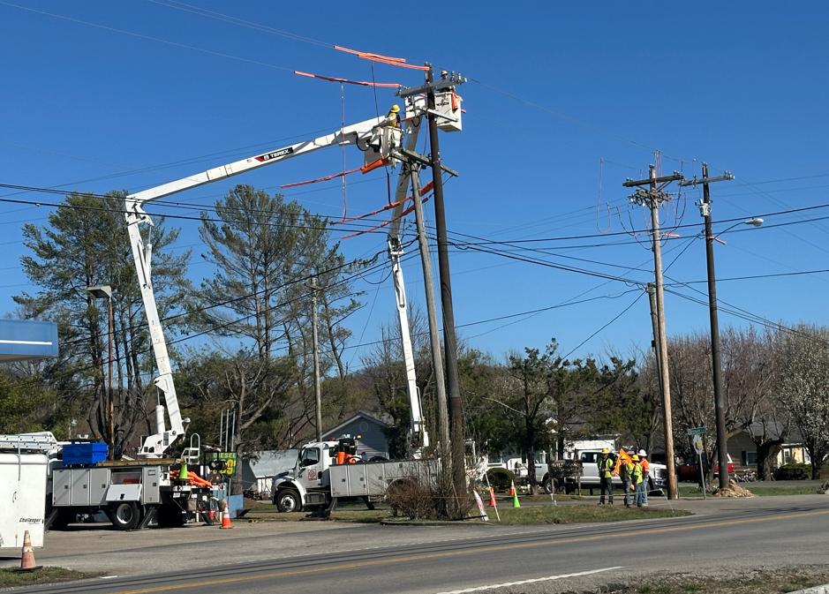
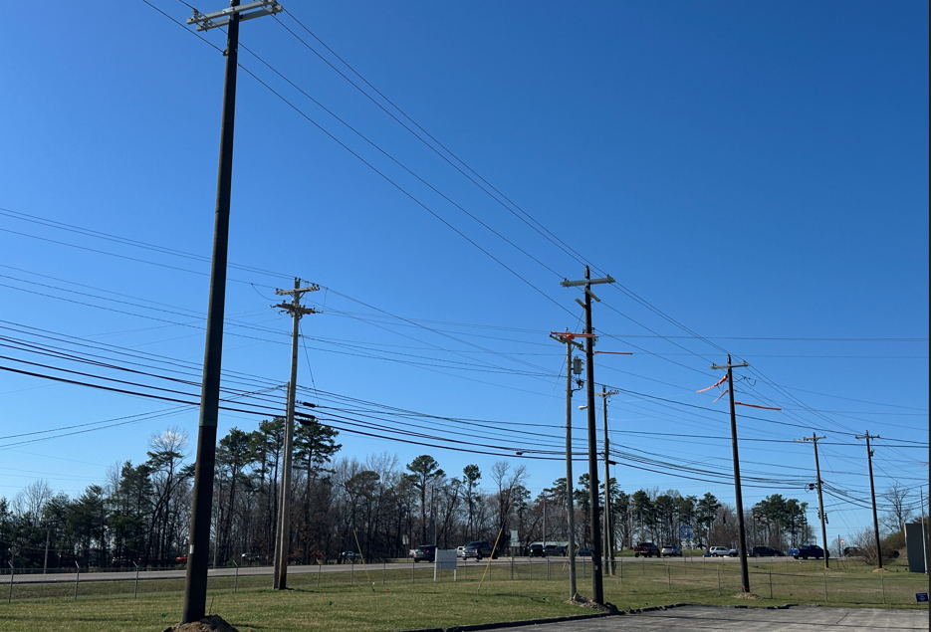
Jackson Energy
October 2024 – Executed Agreement
October 2025 – Began setting poles
June 2026 - Finished
Notes:
Kevin
We finally had ROW cleared for Jackson Energy to start setting poles in October 2025.
They finished up in June.

Slide 24
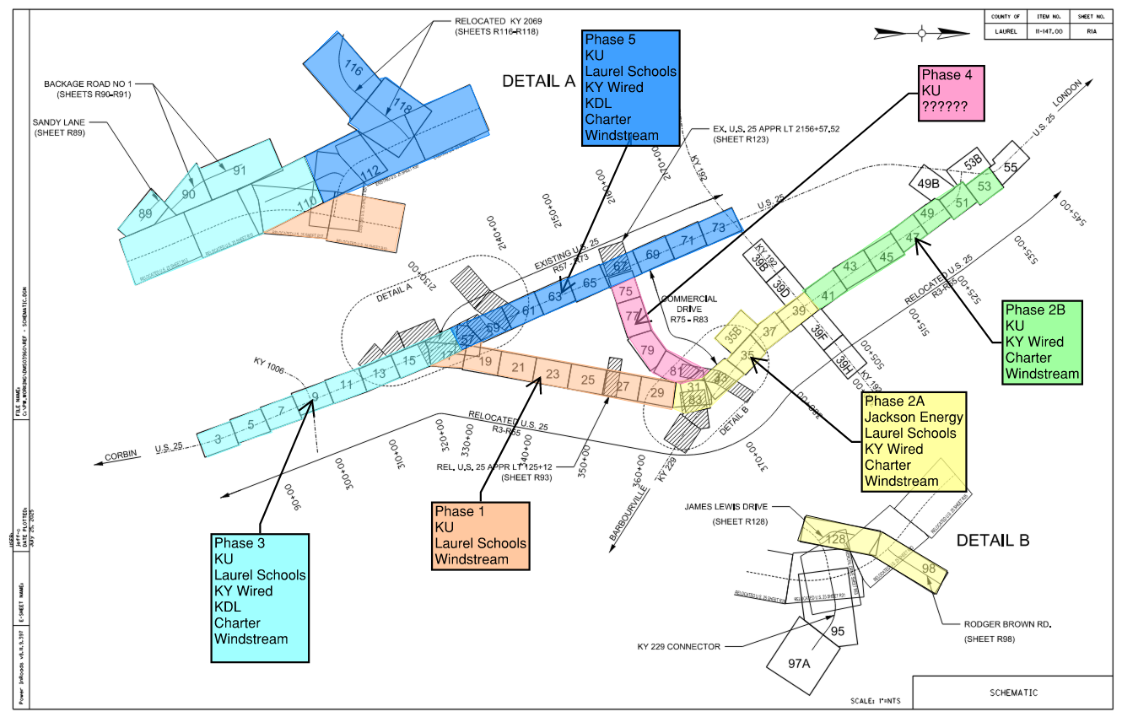
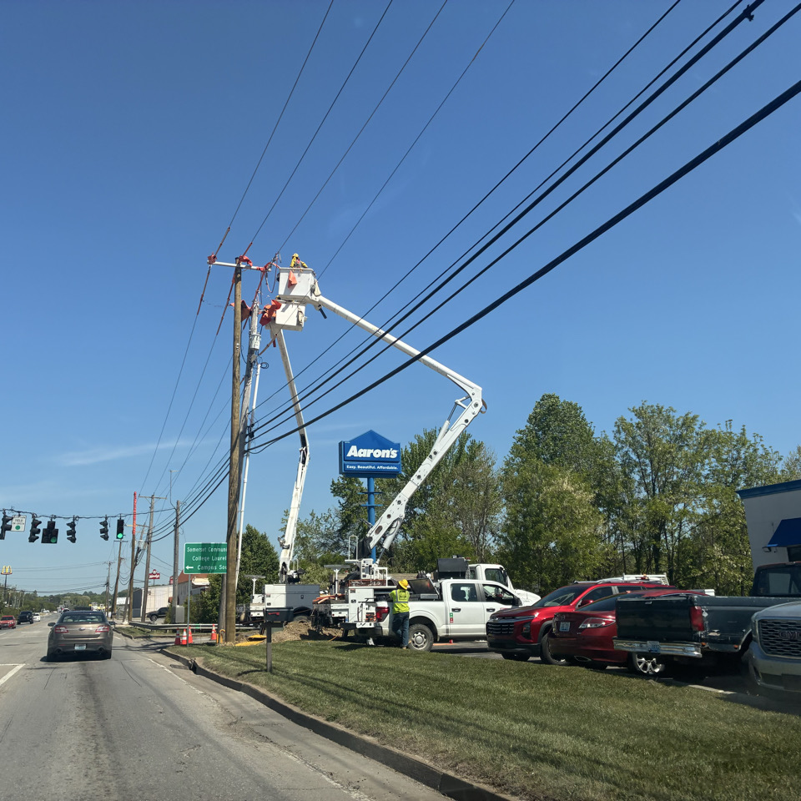
Continued Overhead Utility Coordination
Notes:
Kevin
We’re finally making some progress….
Palmer had developed the phasing schematic to emphasize the priority corridor along the new alignment (Phase 1, 2, and 3) with Phase 4 to be along US 25.
Who’s next on the pole lines?
We discovered during our utility coordination meetings that the companies did not know their pecking order.
We updated the phasing plan to also show the order of utilities on the poles.

Slide 25
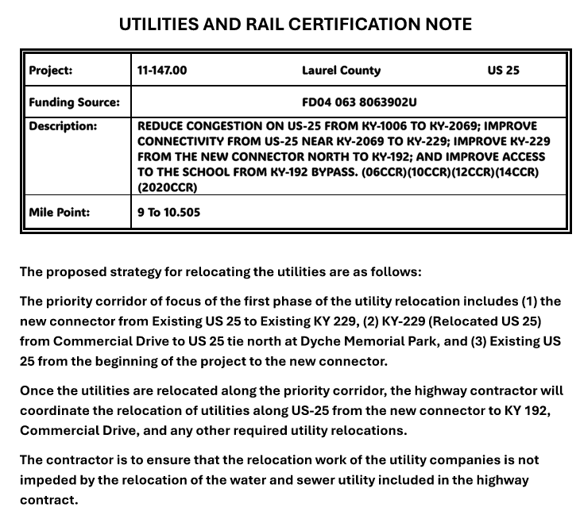
Utility Certification Note
Project Includes Bid Item for Utility Coordination by the Contractor -- How much?
Notes:
Kevin
Palmer drafted the Utilities Certification to communicate the phasing sequence.
The project included a bid item for the contractor to coordinate utilities.
A note was included with the project that the contractor was responsible for all utility coordination and would not be allowed to file a delay based on utilities.

Slide 26
Project Management Lessons for a Utility Man
Face Real Risks Immediately
The Lesson: Lead character Tommy Norris famously shuts down corporate denial by pointing out that you cannot run a volatile operation by pretending it is safe.
PM Application: Do not hide bad news or sugarcoat project metrics. Address timeline delays, budget shortages, and technical failures early before small risks turn into full-scale disasters.
Notes:
Kevin

Slide 27
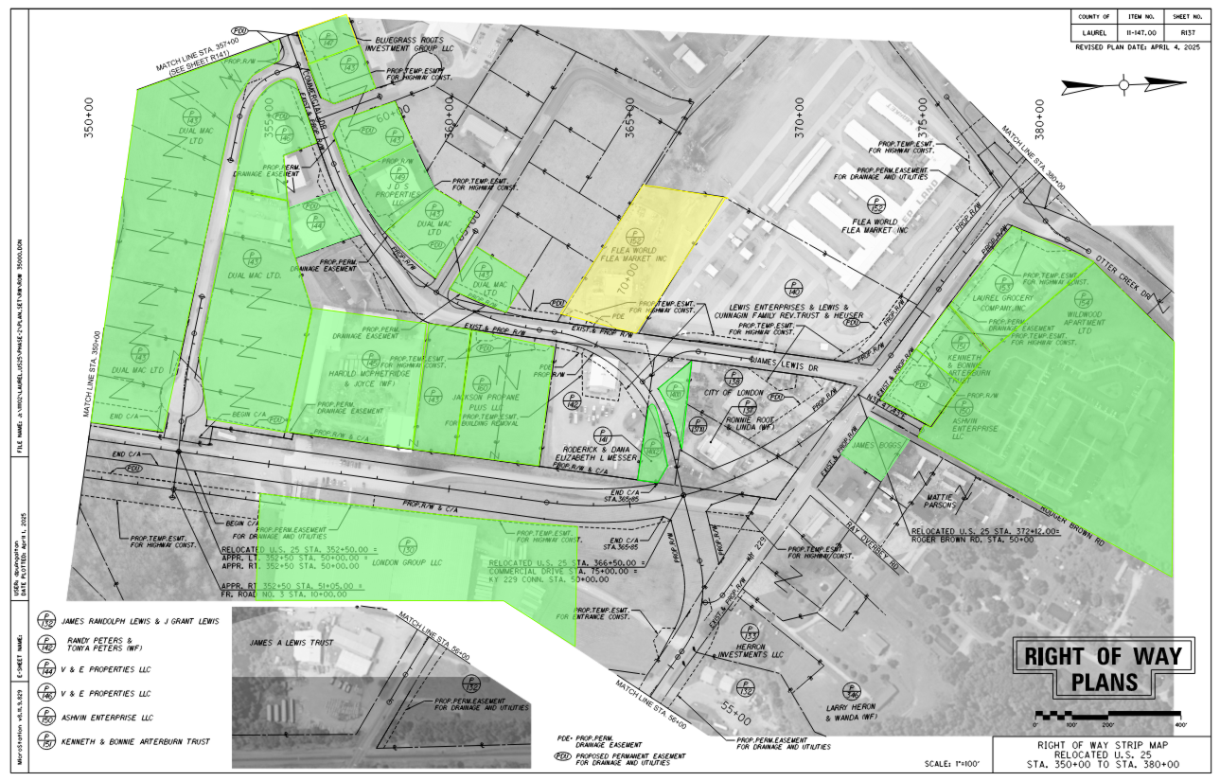
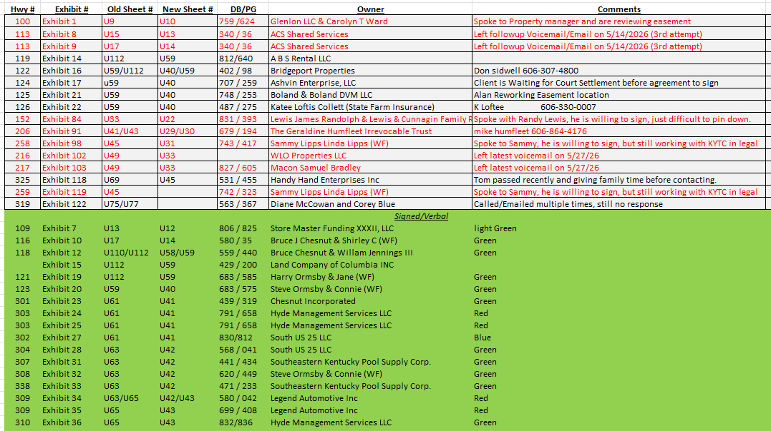
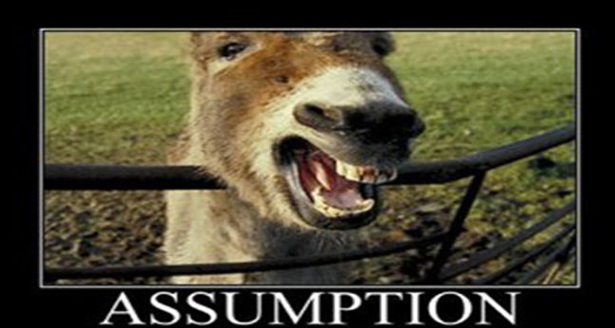
London Utility Commission – No Easements Acquired!
We established Weekly Meetings with LUC
Developed an exhibit and spreadsheet to track progress
District 11 tweaked the project design to assist with the acquisitions
District 11 provided contact info from ROW process
Will Bite You in the….
Notes:
Kevin
ASSumption that LUC was working on their easements.
As we were finishing up the LUC plans in September 2025, we learned that (1) no easements had been acquired and (2) that plats were not finished.
We started meeting with LUC weekly to keep pressure on the easement acquisitions.
LUC also worked with their engineering firm to tweak the design and easements to reduce the impact or at least address a property owner’s request.
We worked with them to develop spreadsheets to track the easements.
Developed another exhibit to track the progress of the easement acquisitions, with emphasis on the priority section.
Note: this work continues now and LUC has started compensating for the easements.

Slide 28
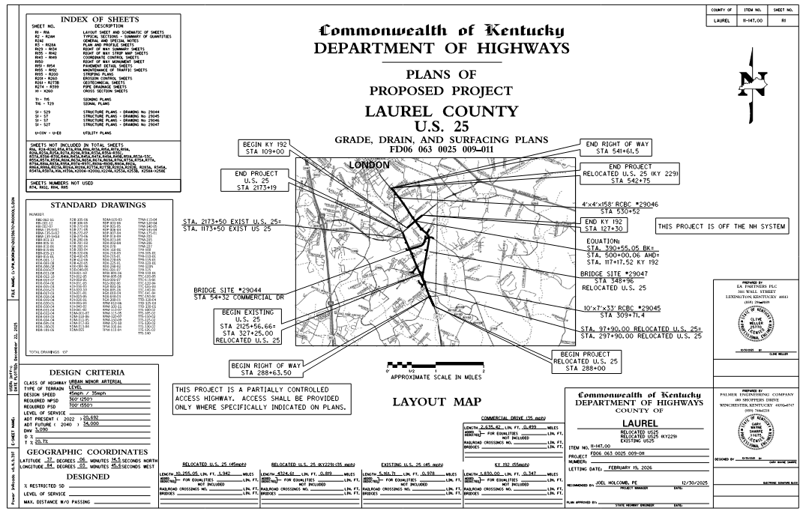
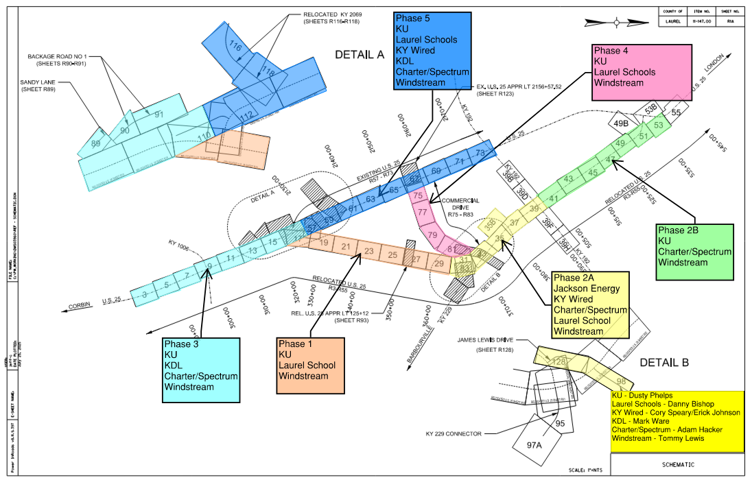
July 2026 Letting
Condemnation parcels delayed the letting until this summer
Contractor the construction letting and reports that utilities cannot be cleared
Planned Utility Phasing v. Highway Construction Phasing
Utility Coordination Meeting on July 23, 2026
Notes:
Kevin
July 2026 Letting
We started hearing complaints from the contractors that the utility companies would not be cleared in time to meet the project schedule.
During the July 23, 2026 utility coordination, we walked all of the companies through the phasing secquence.
Both Windstream and Charter inform us that they cannot clear US 25 as two project sections. And that the utility clearance will take another year for the corridor.
This was shocking news to our team as they had never said that before.
Discuss the July advertisement and having to pull the project.
The milestones were too tight for the utilities, after the KY 192 project was pulled out.
We also learned that neither Windstream or Charter would not cut their fiber for the two US 25 sections had to adjust the milestons accordingly.

Slide 29


August 2026 Letting
ATS Bid $40,000 for Utility Coordination
“Utilities seem to be in good shape. We talked to the companies, and they told us they can meet the schedule.”
- Brian Billings, VP, ATS Construction
Notes:
Kevin
Present the updated Construction Milestone Schedule with the Utility Milestones.
The priority remained having the new corridor opened on time.
Shoutout to Eric Hackworth at EA Partners

Slide 30
Landman Project Management Lessons
Take Total Ownership During Crises
The Lesson: When accidents or disasters strike on the patch, Tommy does not pass the buck; he steps right into the chaos, takes responsibility, and starts giving direct orders.
PM Application: When a project goes off the rails, stop looking for someone to blame. Step up immediately, coordinate the recovery steps, and guide your team through the resolution.
Notes:
Kevin
Disaster struck on August 20th, the same day as the successful letting of the project.

Slide 31




LUC and
Delta Gas Conflicts
Notes:
Kevin
We learned of serious conflicts between LUC and Delta Gas.
I was sick! Sherri and Cody were so frustrated! We were all so frustrated! How had we missed this?
While we had worked closely to work out conflicts with LCWD#2, somehow this fell through the cracks with LUC.
We had coordinated this early with Delta Gas and had been assured it would not be an issue.
At the end of the day, the companies didn’t talk and we had not ensured that they had seen each others plans.
Since August 20th, we have met multiple times with the companies each week to identify and resolve the conflicts.
Fortunately, Delta Gas is one of the best utility companies in D11 to work with. They have been willing to work with LUC and make adjustments where they can.
We are near the resolution of all of these conflicts, with only a few locations requiring revisions to the design.
When disaster strikes, own it and fix it!

Slide 32


STEPH IS BETTER THAN SUE
Questions?
LUC
Notes:
Kevin
Shout out to Stephanie Blain.
Stephanie’s experience designing water, sewer and gas has been critically important to working out the conflicts.
While I am a big fan of subsurface utility exploration, I am an even bigger fan of my partner in crime – Stephanie Blain.
She is the best…. Steph is better than SUE!

Slide 33

Notes:
Kevin
Shoutout to Sherri Chappel
We had one remaining parcel that had not been resolved.
While we had IOJ ROE, we did not have the conflicts fully resolved with the property owner.
This parcel was also the primary parcel for shutting KU’s work down.
LUC was also going to relocate in the permanent utility easement.
Sherri and her team came up with an alternative solution that placed a permanent utility easement around the back of the gas station property.
The deal was finally signed the last week of August.

Slide 34





Charter / Spectrum
By the end of September 2025, the letting date shifted from October to November 2025 because of the condemnation parcels. We had all of the plans, estimates and agreements, except for Charter.
November 2025
  Sent multiple firm emails to Charter pushing for plans and estimate plans
  Jennifer McCleve followed up with emails “requesting Charter’s immediate support”.
December 2025
  Received Plans and Estimate 12-09-25
  Agreement Executed 12-30-25
ASK THE HAMMER
Notes:
I also want to give a shoutout to Jennifer McCleve and her team in the Utility Branch. We have leaned on their expertise as we faced each challenge.
I have one last story to tell. We had to Call The Hammer (Jennifer) to close the deal with Charter Communications.
As the project letting date started shifting from October to November, the Charter plans and estimates because a sticky point.
We assumed we had everything in order. But were promised plans from our project contact for weeks, and getting lame excuses week after week.
Our local contact said that he had the plans ready but the legal department would not give him approval to send them to us.
We reached out to Central Office and learned that Charter had tried and failed to get the General Assembly to make all communication companies the equivalent of municipalities.

Slide 35

New Series!
Featuring
Jennifer McCleve
Special Appearances
Emily Eising
Pat Eckert
Cherie Peterman
Notes:
Kevin
BTW, did you know that we will soon have a Landman spinoff…….
Utility Woman!

Slide 36
TEAMwork and TEAMmembers!
Communication!
Coordination!
Collaboration!
Commitment!
Creativity!
Lessons Learned
Notes:
Kevin

Slide 37
Questions?
Thank You!
We will be happy to take questions

